Slide 1
Module 1: Lesson 1: Cloud Concepts
Cloud Concepts

Slide 2





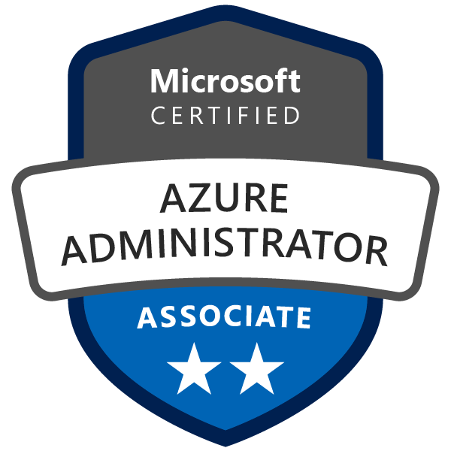
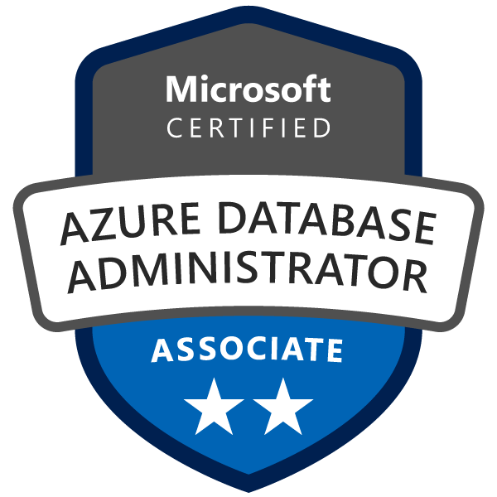
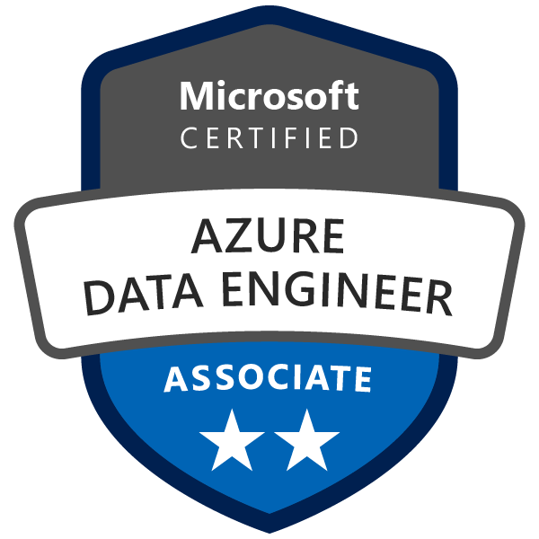
About The Presenter
Aaron Hughes
Senior Data and Analytics Consultant
17X Microsoft Certified
10 Years experience
Developed many SQL Server and Azure Modern Data Platform Solutions
LinkedIn
Azure Business Intelligence
Notes:
How Cloud Can Help DevOps Transformation

Slide 3


Lesson 1: Overview
This lesson will cover
Define cloud computing
Describe Public cloud
Describe Private cloud
Describe Hybrid cloud
Compare and contrast the three different cloud models
Notes:
How Cloud Can Help DevOps Transformation

Slide 4
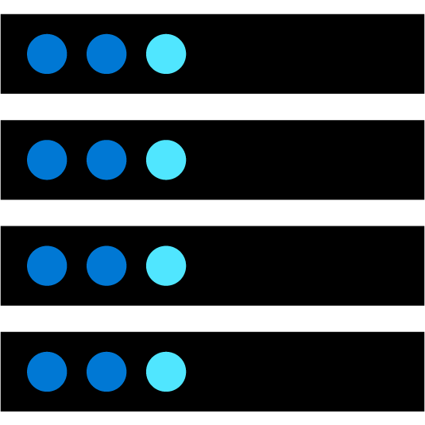



Cloud Computing
What is cloud computing?
Cloud Computing is the delivery of computing services over the internet, enabling faster innovation, flexible resources, and economies of scale.
Compute
Storage
Analytics
Compute
Networking
Storage
Analytics
Networking
Notes:
Cloud Computing is:
A model for enabling on-demand access to a shared pool of configurable computing resources – servers, network, storage, applications, and services
Ubiquitous, convenient, on-demand network access
Rapidly provisioned and released with minimal management effort or service provider interaction
Definitions found at:
Cloud computing - https://azure.microsoft.com/en-us/overview/what-is-cloud-computing/
NIST definition - https://csrc.nist.gov/publications/detail/sp/800-145/final
Learn and SkillPipe content order note: https://docs.microsoft.com/en-us/learn/modules/intro-to-azure-fundamentals/what-is-cloud-computing
There are 4 additional slides in Learn (and SkillPipe) that cover a high level introduction to Azure:
What is Azure? https://docs.microsoft.com/en-us/learn/modules/intro-to-azure-fundamentals/what-is-microsoft-azure
Tour of Azure Services https://docs.microsoft.com/en-us/learn/modules/intro-to-azure-fundamentals/tour-of-azure-services
Get started with Azure accounts https://docs.microsoft.com/en-us/learn/modules/intro-to-azure-fundamentals/get-started-with-azure-accounts
Case study introduction (Tailwind Traders) https://docs.microsoft.com/en-us/learn/modules/intro-to-azure-fundamentals/case-study-introduction Throughout the Azure Fundamentals learning paths, we'll work with Tailwind Traders, a fictitious home improvement retailer. It operates retail hardware stores across the globe and online. The scenarios are in both the SkillPipe and Learn content.

Slide 5
Cloud Models
What are public, private, and hybrid clouds?
Public cloud –
Services are offered over the public internet and available to anyone who wants to purchase them.
Cloud resources, such as servers and storage, are owned and operated by a third-party.
Private cloud –
Consists of computing resources used exclusively by users from one business or organization.
Can be physically located at your organization's on-site datacenter, or it can be hosted by a third-party.
Hybrid cloud –
Computing environment that combines a public cloud and a private cloud.
Allows data and applications to be shared between them.

Slide 6
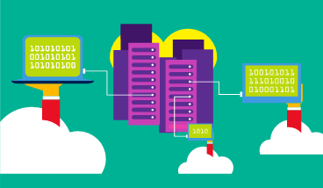
Public Cloud
No capital expenditures to scale up.
Applications can be quickly provisioned and deprovisioned.
Organizations pay only for what they use.
Notes:
What are public, private, and hybrid clouds? - https://azure.microsoft.com/en-us/overview/what-are-private-public-hybrid-clouds/

Slide 7
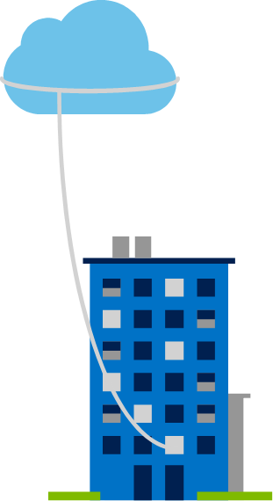
Private Cloud
Hardware must be purchased for start-up and maintenance.
Organizations have complete control over resources and security.
Organizations are responsible for hardware maintenance and updates.
Notes:
Owned and operated by the organization that uses cloud resources.
Organizations create a cloud environment in their datacenter.
Self-service access to compute resources provided to users within the organization.
Organization is responsible for operating the services they provide.

Slide 8
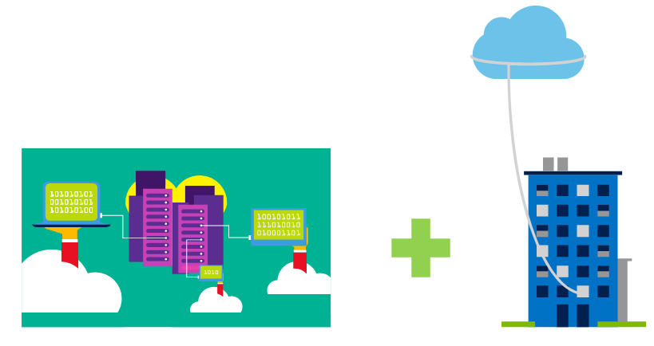
Hybrid Cloud
Provides the most flexibility.
Organizations determine where to run their applications.
Organizations control security, compliance, or legal requirements.
Notes:
Hybrid cloud models have the following characteristics:
Resource location. Specific resources run or are used in a public cloud, and others run or are used in a private cloud.
Cost and efficiency. Hybrid cloud models allow an organization to leverage some of the benefits of cost, efficiency, and scale that are available with a public cloud model.
Control. Organizations retain management control in private clouds.
Skills. Technical skills are still required to maintain the private cloud and ensure both cloud models can operate together.

Slide 9
Cloud Benefits
High availability
Fault tolerance
Scalability
Elasticity
Global reach
Customer latency capabilities
Agility
Predictive cost considerations
Disaster recovery
Security
Notes:
High availability: Depending on the service-level agreement (SLA) that you choose, your cloud-based apps can provide a continuous user experience with no apparent downtime, even when things go wrong.
Scalability: Apps in the cloud can scale vertically and horizontally:
Scale vertically to increase compute capacity by adding RAM or CPUs to a virtual machine.
Scaling horizontally increases compute capacity by adding instances of resources, such as adding VMs to the configuration.
Elasticity: You can configure cloud-based apps to take advantage of autoscaling, so your apps always have the resources they need.
Agility: Deploy and configure cloud-based resources quickly as your app requirements change.
Geo-distribution: You can deploy apps and data to regional datacenters around the globe, thereby ensuring that your customers always have the best performance in their region.
Disaster recovery: By taking advantage of cloud-based backup services, data replication, and geo-distribution, you can deploy your apps with the confidence that comes from knowing that your data is safe in the event of disaster.

Slide 10
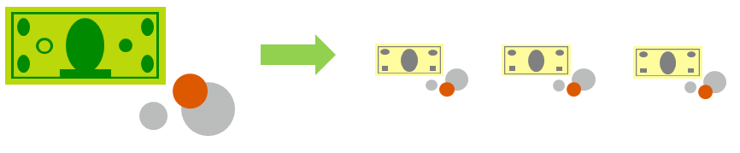
CapEx vs. OpEx
Capital Expenditure (CapEx)
The up-front spending of money on physical infrastructure.
Costs from CapEx have a value that reduces over time.
Operational Expenditure (OpEx)
Spend on products and services as needed, pay-as-you-go
Get billed immediately

Slide 11

Consumption-based model
Cloud service providers operate on a consumption-based model, which means that end users only pay for the resources that they use. Whatever they use is what they pay for.
Better cost prediction
Prices for individual resources and services are provided
Billing is based on actual usage
Notes:
This consumption-based model brings with it many benefits, including:
No upfront costs.
No need to purchase and manage costly infrastructure that they may or may not use to its fullest.
The ability to pay for additional resources when they are needed.
The ability to stop paying for resources that are no longer needed.

Slide 12
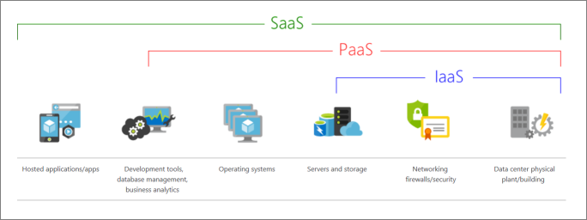
Cloud Service
What are cloud service models
Iaas - Infrastructure-as-a-Service
Paas - Platform-as-a-Service
Saas - Software-as-a-Service
Notes:
Infrastructure-as-a-Service
This cloud service model is the closest to managing physical servers; a cloud provider will keep the hardware up-to-date, but operating system maintenance and network configuration is up to you as the cloud tenant. For example, Azure virtual machines are fully operational virtual compute devices running in Microsoft datacenters. An advantage of this cloud service model is rapid deployment of new compute devices. Setting up a new virtual machine is considerably faster than procuring, installing, and configuring a physical server.
Platform-as-a-Service
This cloud service model is a managed hosting environment. The cloud provider manages the virtual machines and networking resources, and the cloud tenant deploys their applications into the managed hosting environment. For example, Azure App Services provides a managed hosting environment where developers can upload their web applications, without having to worry about the physical hardware and software requirements.
Software-as-a-Service
In this cloud service model, the cloud provider manages all aspects of the application environment, such as virtual machines, networking resources, data storage, and applications. The cloud tenant only needs to provide their data to the application managed by the cloud provider. For example, Microsoft Office 365 provides a fully working version of Microsoft Office that runs in the cloud. All you need to do is create your content, and Office 365 takes care of everything else.

Slide 13
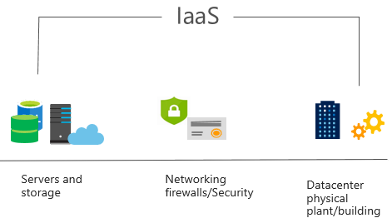
Infrastructure as a Service (IaaS)
Advantages
No CapEx
Agility
Management
Consumption-based model
Skills
Cloud benefits
Flexibility
Notes:
Most basic cloud computing services category.
Build pay-as-you-go IT infrastructure by renting servers, virtual machines, storage, networks, and operating systems from a cloud provider.
Instant computing infrastructure, provisioned and managed over the internet.

Slide 14
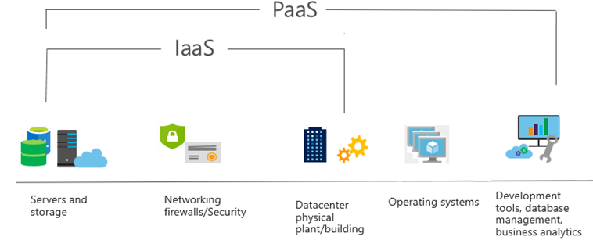
Platform as a Service (PaaS)
Advantages
No CapEx
Agility
Consumption-based model
Skills
Cloud benefits
Productivity
Disadvantages
Platform limitations
Notes:
Provides environment for building, testing, and deploying software applications; without focusing on managing underlying infrastructure.

Slide 15
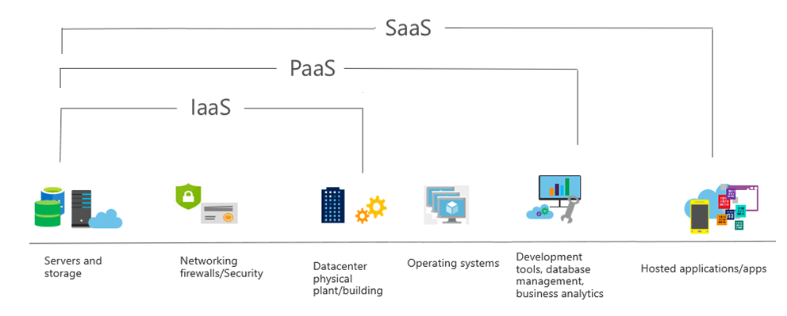
Software as a Service (PaaS)
Advantages
No CapEx
Agility
Pay-as-you-go pricing model
Flexibility
Disadvantages
Software limitations
Notes:
Provides environment for building, testing, and deploying software applications; without focusing on managing underlying infrastructure.

Slide 16
Cloud service comparison
IaaS
PaaS
SaaS
The most flexible cloud service.
Focus on application development.
Pay-as-you-go pricing model.
You configure and manage the hardware for your application.
Platform management is handled by the cloud provider.
Users pay for the software they use on a subscription model.
Notes:
IaaS
The most flexible cloud service.
You configure and manage the hardware for your application.
PaaS
Focus on application development.
Platform management is handled by the cloud provider.
SaaS
Pay-as-you-go pricing model.
Users pay for the software they use on a subscription model.

Slide 17
Shared responsibility model
On-Premises
( Private Cloud )
Infrastructure
( as a Service )
Platform
( as a Service )
Software
( as a Service )
On-Premises
( Private Cloud )
Infrastructure
( as a Service )
Platform
( as a Service )
Software
( as a Service )
Data & Access
Data & Access
Data & Access
Data & Access
Applications
Applications
Applications
Applications
You Manage
Runtime
Runtime
Runtime
Runtime
Cloud Provider Manages
Operating System
Operating System
Operating System
Operating System
Virtual Machine
Virtual Machine
Virtual Machine
Virtual Machine
Compute
Compute
Compute
Compute
Networking
Networking
Networking
Networking
Storage
Storage
Storage
Storage
Notes:
IaaS
The most flexible cloud service.
You configure and manage the hardware for your application.
PaaS
Focus on application development.
Platform management is handled by the cloud provider.
SaaS
Pay-as-you-go pricing model.
Users pay for the software they use on a subscription model.

Slide 18




Prepare for The Exam (Q/A)
1. Which of the following choices isn't a cloud computing category?
Infrastructure-as-a-Service (IaaS)
Platform-as-a-Service (PaaS)
Networking-as-a-Service (NaaS)
Software-as-a-Service (SaaS)
2. Which of the following statements is true?
With Operating Expenses (OpEx), you are responsible for purchasing and maintaining your computing resources.
With Operating Expenses (OpEx), you are only responsible for the computing resources that you use.
With Capital Expenses (CapEx), you are only responsible for the computing resources that you use.

Slide 19
Prepare for The Exam (Q/A)
3. Which of the following options isn't a type of cloud computing?
Private cloud
Hybrid cloud
Distributed cloud
Public cloud
4. Which of the following choices isn't a benefit of using cloud services?
High availability
Geographic isolation
Disaster recovery
Scalability

Slide 20

Summary
This lesson has covered
Define cloud computing
Describe Public cloud
Describe Private cloud
Describe Hybrid cloud
Compare and contrast the three different cloud models
Prepare for The Exam(Q/A)
Notes:
How Cloud Can Help DevOps Transformation

Slide 21
Summary
Next Lesson:
Notes:
How Cloud Can Help DevOps Transformation

